Slide 1
TRANSCATHETER MITRAL VALVE
REPLACEMENT DEVICE

Slide 2
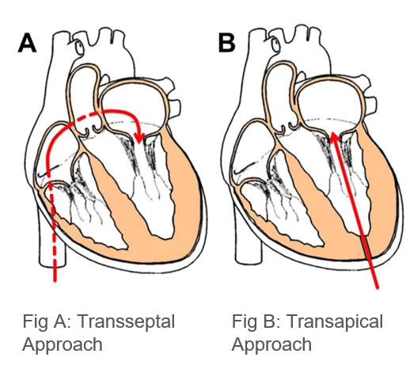
Introduction
Transcatheter mitral valve replacement (TMVR) is a procedure to replace the mitral valve in your heart.
It’s a less invasive alternative to open –heart surgery for people with mitral valve disease. TMVR implants a manufactured (Human-Made) valve or one made from bovine, porcine or human biological heart in the position of the old valve.
The new valve then does the work of the faulty mitral valve. Unlike traditional surgical approaches TMVR is performed through catheters , typically inserted through blood vessels through groin or chest.

Slide 3
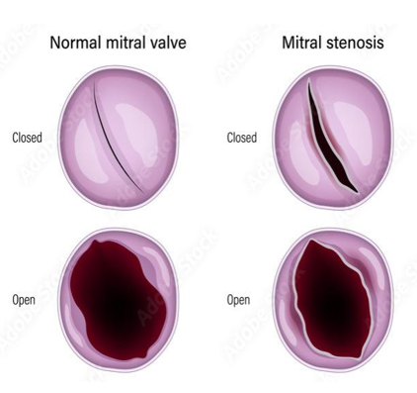
An Overview of Mitral Stenosis
Mitral stenosis (MS) is a condition characterized by obstruction to left ventricular inflow at the level of the mitral valve, often due to Calcification.
In India, mitral stenosis is a significant health concern, with a prevalence of approximately 100-150 cases per 100,000 individuals.
The disease predominantly affects females.
Mitral stenosis, often associated with rheumatic mitral valve disease,
is prevalent in India and contributes to the country's overall
cardiovascular health challenges

Slide 4
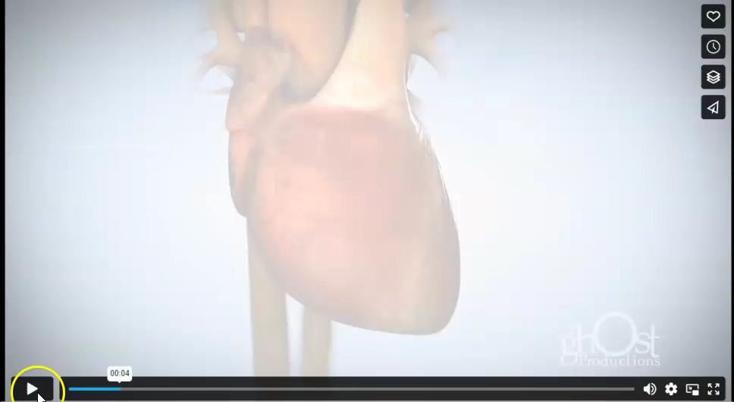

Slide 5
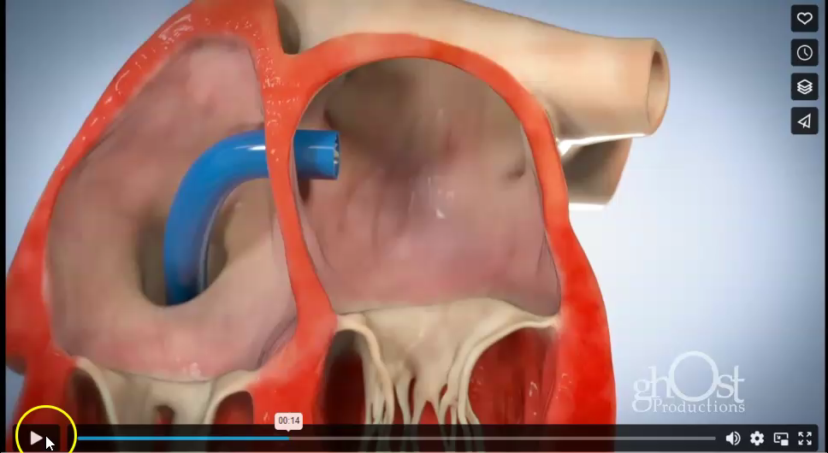

Slide 6
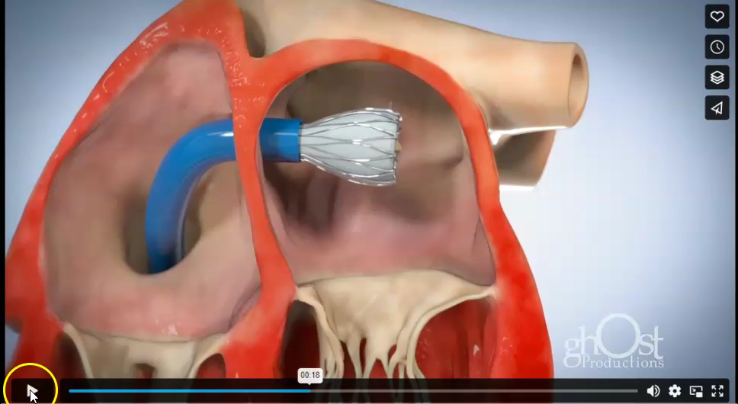

Slide 7
Objective of the project with inline thematic domain
Transcatheter Mitral Valve Replacements (TMVR) encounter challenges in achieving precise device positioning and deployment stability within a beating heart.
We designed a novel dynamically adaptable anchor mechanism.
The objective is to revolutionize TMVR procedures by optimizing device placement, through a transseptal approach, enhancing stability, ensuring durability and repeatability, and minimizing procedural risk, ultimately improving patient outcomes while minimizing associated risks.

Slide 8
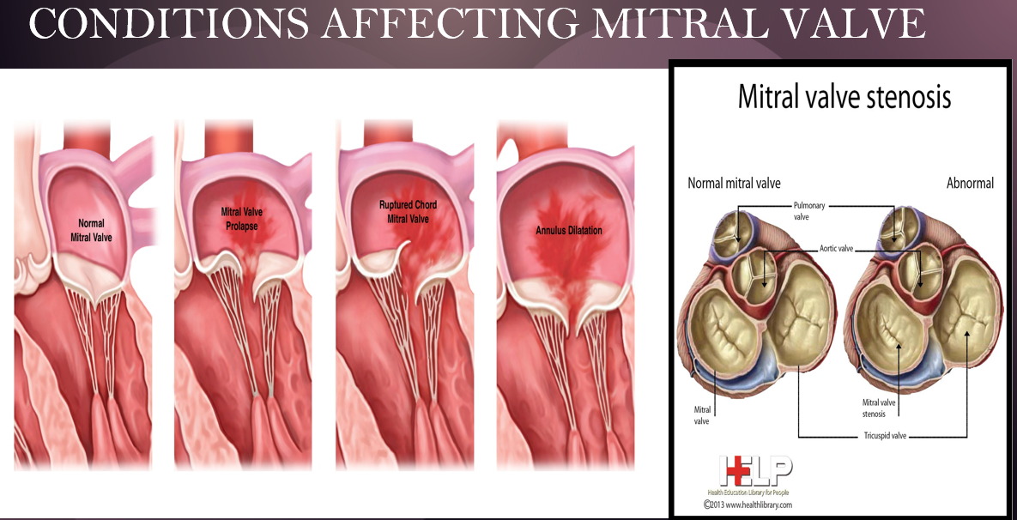

Slide 9
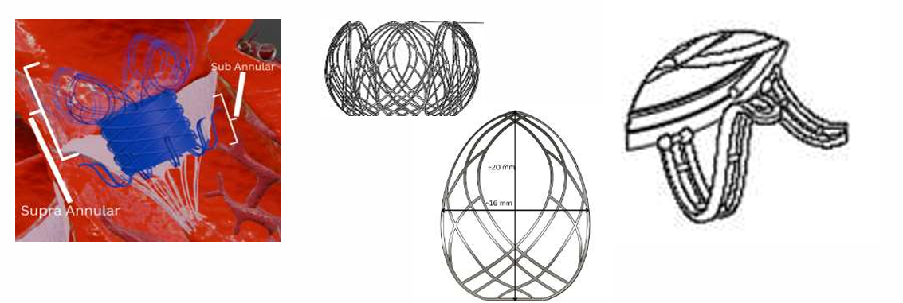
Proposed Solution
Key innovation: Dual
anchorage for
unmatched stability.
Lotus-petal mesh:
Minimizes blood
flow obstruction
Supported dual
filament Design in the
mitral annular clamps.

Slide 10
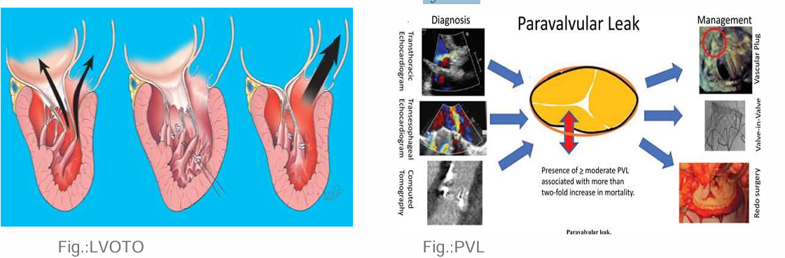
Common Issues In Existing Products
● Dislodgement due to insufficient anchorage
● Paravalvular Leak (PVL)
● Device size and delivery system
● LVOTO

Slide 11
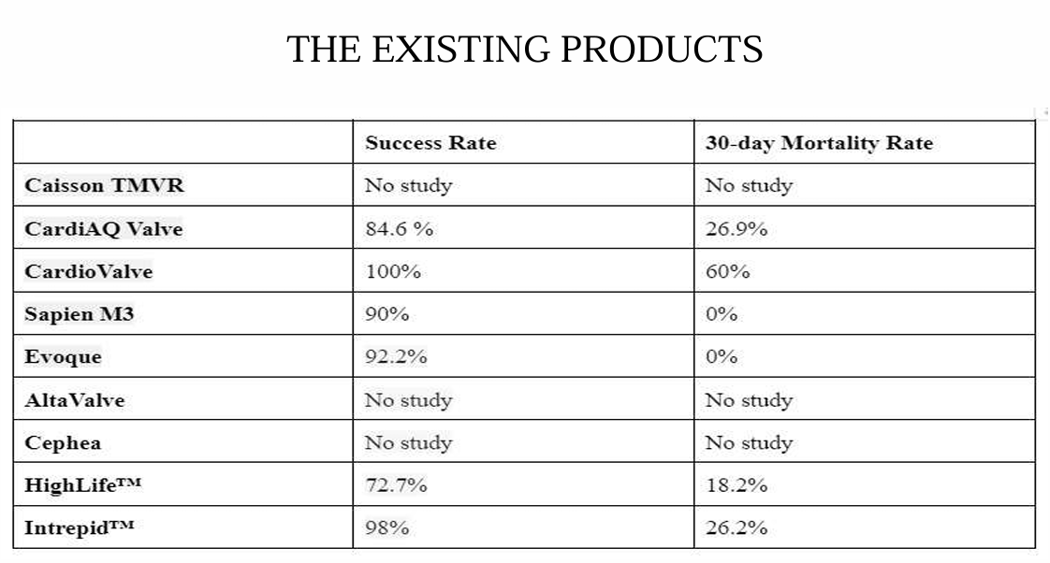
The Existing Products

Slide 12
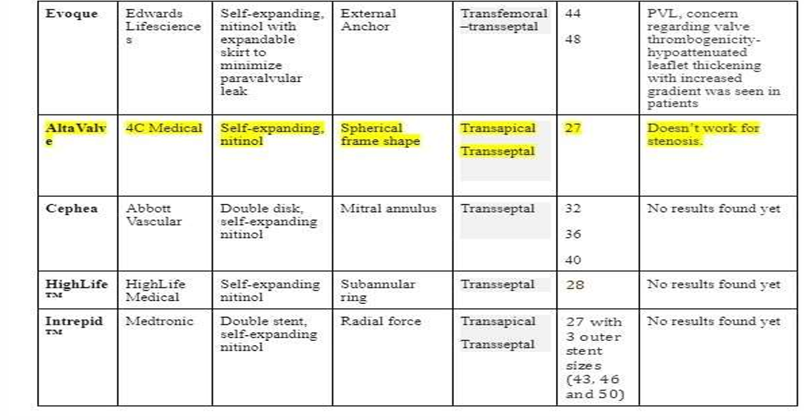

Slide 13
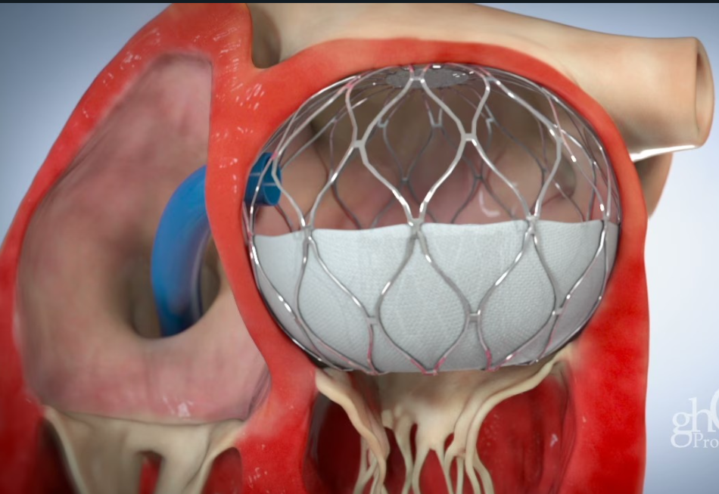
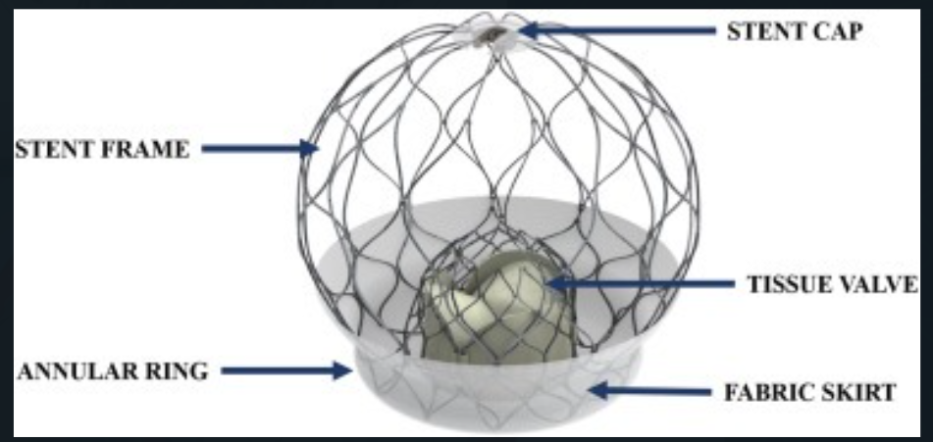
Original Design of Alta Valve

Slide 14

Project Expo

Slide 15
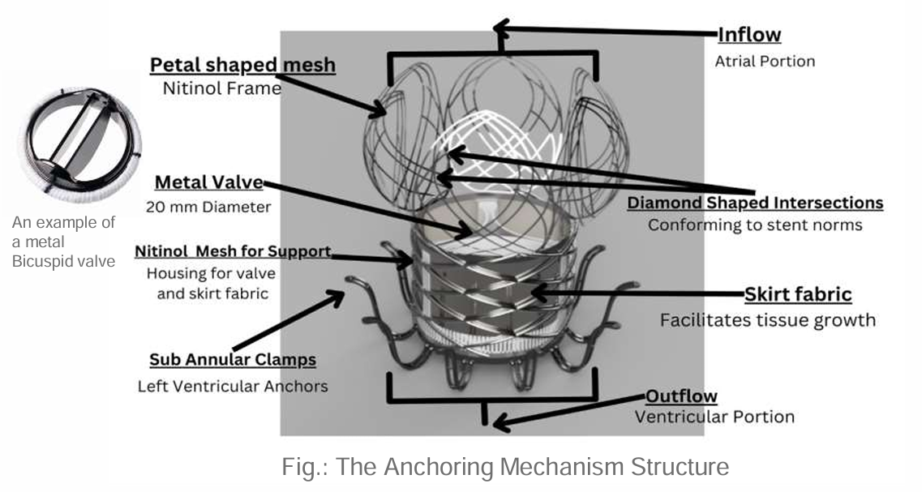
Project Expo

Slide 16
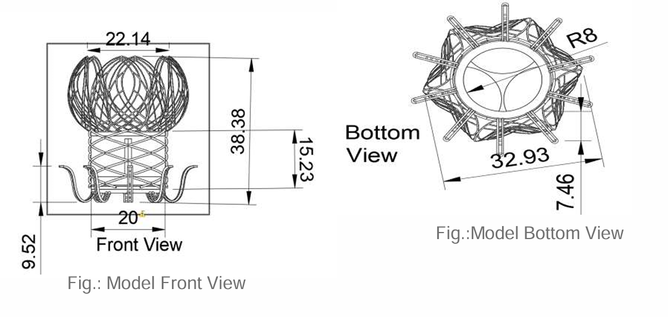
Project Expo
** ALL MEASUREMENTS ARE IN MM.

Slide 17
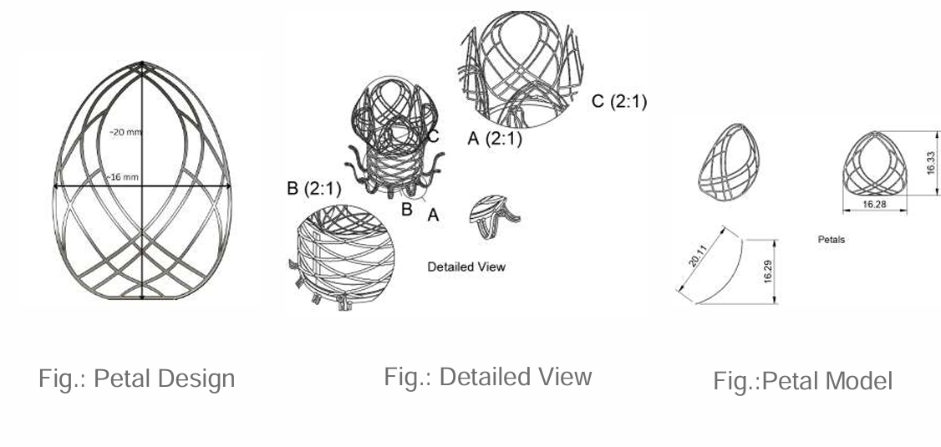
Project Expo
** ALL MEASUREMENTS ARE IN MM.

Slide 18
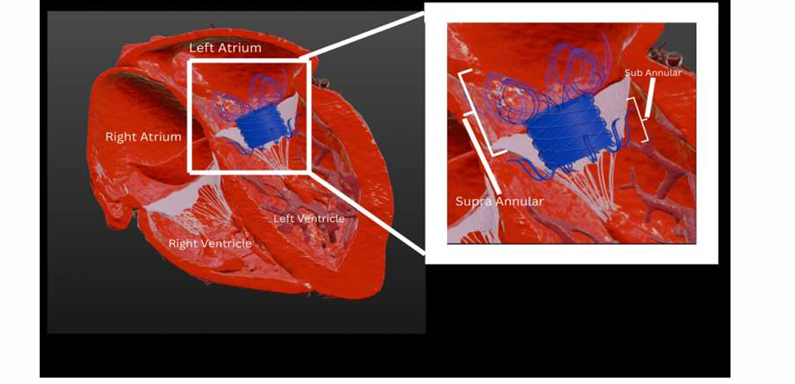
Project Expo
THE VALVE PLACEMENT

Slide 19
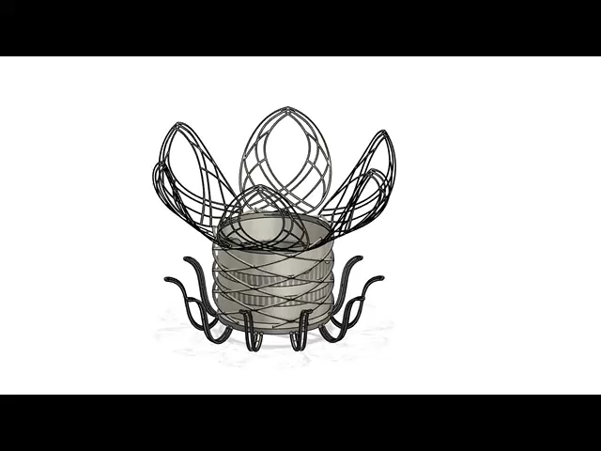
Video Link
Project Expo

Slide 20
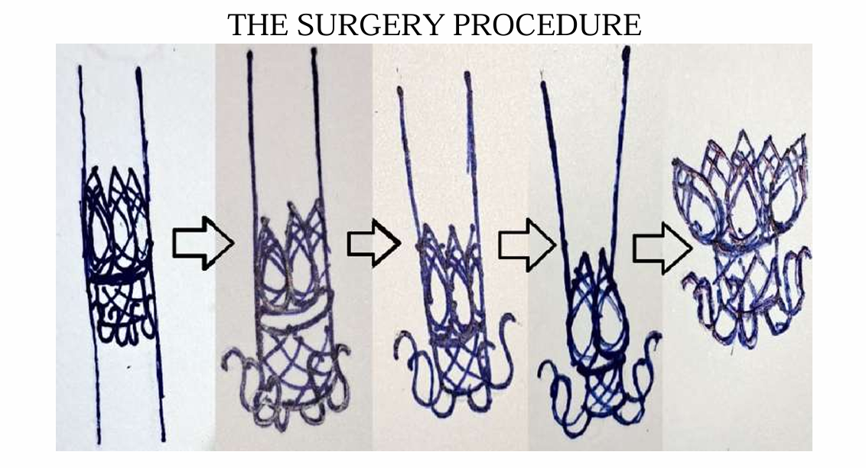
REFERENCES
Project Expo

Slide 21
Our Enhancements
● Nitinol based biocompatible valve
● Transseptal delivery reduces the risks of complications
● Increased structural integrity in comparison to market available valves
● Reduction in risks of LVOT obstruction
● Durable and Repeatable
● Repositionability and Re-capturability
● Compatible with Echocardiography and Fluoroscopy
● No barbs or sharp structure
● Anchoring mechanism is able to withstand blood pressures up to 200 mmHg without dislodging
● The mechanism is able to adapt its shape to wide variations in the anatomy such as ellipticity of mitral valve and can be customizable according to size (diameter) of valve.

Slide 22
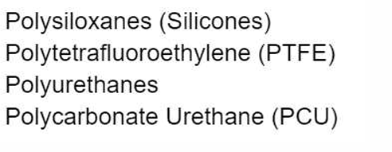
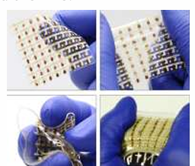
Future Scope
● The use of sensors and stretchable electronics.
The incorporation of sensors and stretchable electronics in TMVR valves represents a cutting-edge approach to improving patient outcomes in mitral valve disease treatment, for providing feedback such as closing and opening rates of the replaced valve and blood flow rate.
● Smart Polymers for better retractability Stimuli responsive polymers can be used in the joints of the mitral annular clamps such that when stimulus is provided, the clamps will droop hence, increasing the ease of retractability

Slide 23
Impact and benefits envisaged
Our TMVR system offers a minimally invasive solution for mitral valve disease with a self-expanding nitinol mesh and lotus-petal-like anchors for exceptional stability and resilience.
The dual-anchorage system provides superior structural integrity. The deployment method through transseptal delivery and high-pressure resistance mitigate the risk of LVOT obstruction.
Notable features include ease of repositioning, stability, and scalability, setting a new standard for TMVR systems.
This cutting-edge design promises enhanced patient outcomes, improved procedural efficacy, and significant advancements in cardiac interventions.

Slide 24
References
1) AOUN J. ET AL. (2023); TRANSCATHETER MITRAL VALVE REPLACEMENT WITH DEDICATED DEVICES; DOI: 10.14797/MDCVJ.1231; PMCID: PMC10198241; PMID: 37213879
2)GOEL S. ET AL. (2019); TRANSCATHETER MITRAL VALVE THERAPY WITH NOVEL SUPRA-ANNULAR ALTAVALVE: FIRST EXPERIENCE IN THE UNITED STATES; VOL. 1, ISSUE 5; HTTPS://DOI.ORG/10.1016/J.JACCAS.2019.10.034
3)Ascione G, Denti P. Transcatheter Mitral Valve Replacement and Thrombosis: A Review. Front Cardiovasc Med. 2021 Jun 4;8:621258. doi: 10.3389/fcvm.2021.621258. PMID: 34150861; PMCID: PMC8212998.
(for thrombotic risk table)
4) ZAFAR H. ET AL. (2023); COMPLEX MITRAL VALVE ANATOMY AND OPEN ISSUES IN TRANSCATHETER MITRAL VALVE REPLACEMENT; HTTPS://DOI.ORG/10.1016/J.SIPAS.2023.100182; HTTP://CREATIVECOMMONS.ORG/LICENSES/BY/4.0/

Slide 25
THANK YOU!

